Slide 1

GROUP 3
ANALYZING WALMART DATA
Presented by
Apurva Tawde, Himani Garg, Joshua Gavin,
Mayuresh Wani, Neha Khanna

Slide 2

SUMMARY OF CONTENTS
Objective
Walmart Data-Set
Imputation of Missing Variable
Clustering
Market Analysis
Location Analysis
Conclusion
OUR MAIN
TOPICS TODAY
Project Group 3

Slide 3

OBJECTIVE
Analyzing the Walmart data, coupled with external research to understand:
Significant factors affecting the sales
Trend in the sales from FY2011 – FY2016
Location Analysis to determine dominant states
Project Group 3

Slide 4
DATASET
Store
Weekly Sales
Features
45 Walmart Stores
Department
Store Type
Store Size
2010-02-05 – 2012-11-01
Weekly Sales by store
Special holiday week
Department
Factors affecting sales
Weekending Date
Temperature
Fuel Price
CPI
Continued….
Unemployment
IsHoliday
Markdown 1-5
Project Group 3

Slide 5
Imputation of Missing Data
More than 6000 observations with multiple variables
Only 27% of the data remains if we get rid on the missing values
Mean substitution
Easy, but
Decreases the variation
Does not preserve the relationships among variables
Considerable change in the values of correlation
K Nearest Neighbor Imputation
Model structure is determined by the data
Feature Similarity
K = 11
Project Group 3

Slide 6
CLUSTERING
A method of grouping datapoints together for easier interpretation
Grouped all the datapoints to 10 clusters
Used k-means clustering due to better accuracy and easier interpretation
3 different cluster centers will be explored
One without Markdown (NA data omitted)
One with Markdown (NA data omitted)
One with everything and sales data added (NA Data Replaced)
Date was interpreted with an ID column each week with a corresponding ID number from 1-183
Most important information within clustering is the cluster centers, which are averages of each of the different variables within each cluster
Project Group 3

Slide 7
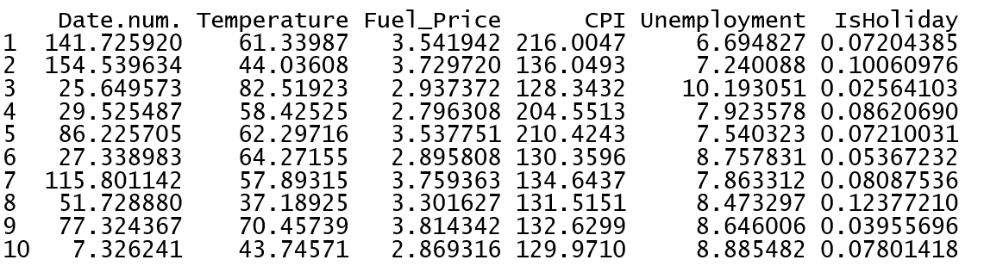
Cluster Centers no Markdown (93%) of Data
Project Group 3

Slide 8
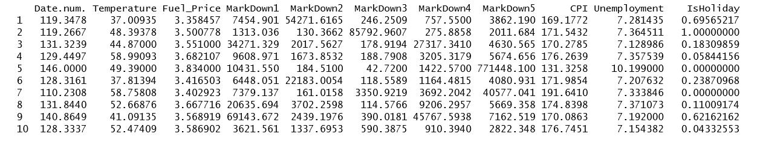
Cluster Centers with Markdown (27% of Data)
Project Group 3

Slide 9
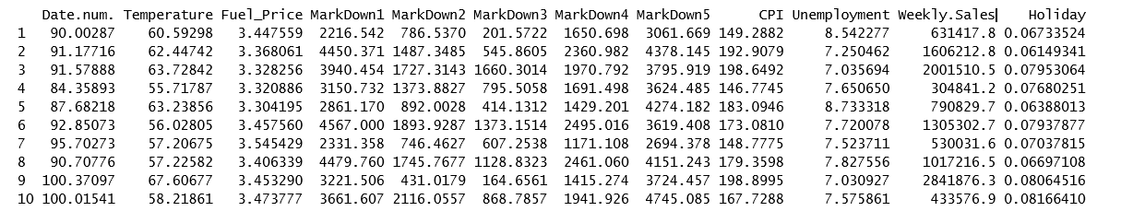
Cluster Centers with All Variables and Data Replacement
Project Group 3

Slide 10

MARKET ANALYSIS
WHY
Help reduce the problems
Create opportunities
Look at past issues to decrease future risks
HOW
External Walmart study
Analysed internal dataset
WHAT
What are the trend in sales?
What are significant factors?
What are the profit-making strategies that were taken over?
Project Group 3

Slide 11
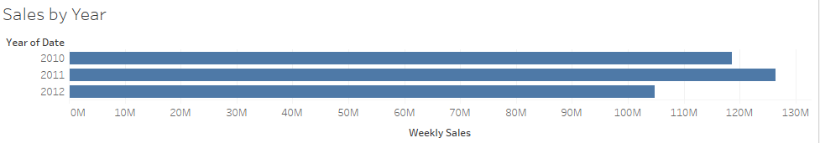
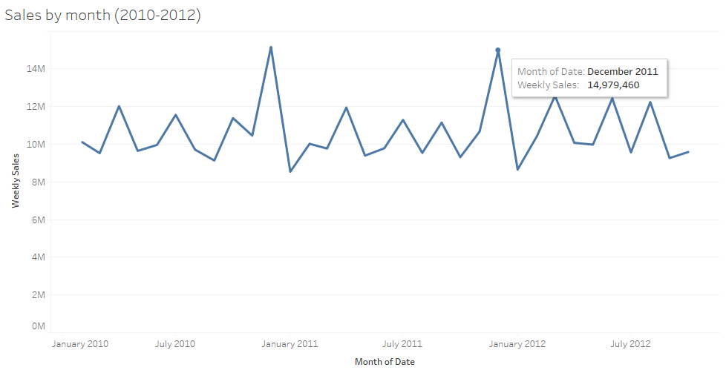
SALES TREND FROM 2010-2012
WHAT LED TO INCREASED SALES IN 2011?
April 2011 : Investment in social e-commerce business
October 2011 : Opened 3 new markets, same day and city, Wichita
Nov 2011: Launched new mobile application
Nov 2011 : Free shipping on all electronic items
December 2011 : Offers lowest prices during “Big Christmas Event”
Project Group 3

Slide 12
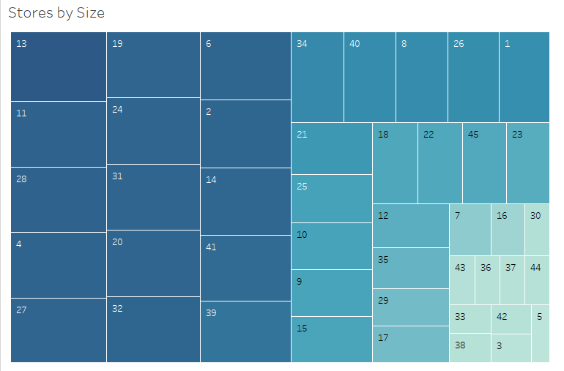
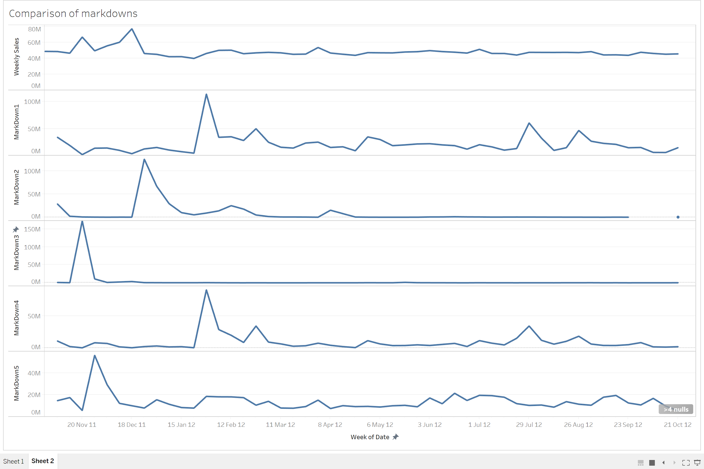
IMPACT OF MARKDOWNS AND STORE SIZE ON SALES
Positive spikes in sales with high values of MarkDown3, MarkDown2, and Mardown5, Thanksgiving and Christmas
Markdown1 around February 2012 did not impact sales
Larger stores correspond to high number in sales
Supercenter #2, operating 24*7, keeping larger stock
Project Group 3

Slide 13




Location Analysis: Methodology
Extract
Compare
Population Employment Data from Gov. Website
Compare the actual Unemployment rate of State against the one in Walmart data set.
Calculate
Plot
In the Walmart Data set Calculate the Annual Average Unemployment Rate
45 Stores are Mapped with 25 States of US.
Project Group 3

Slide 14
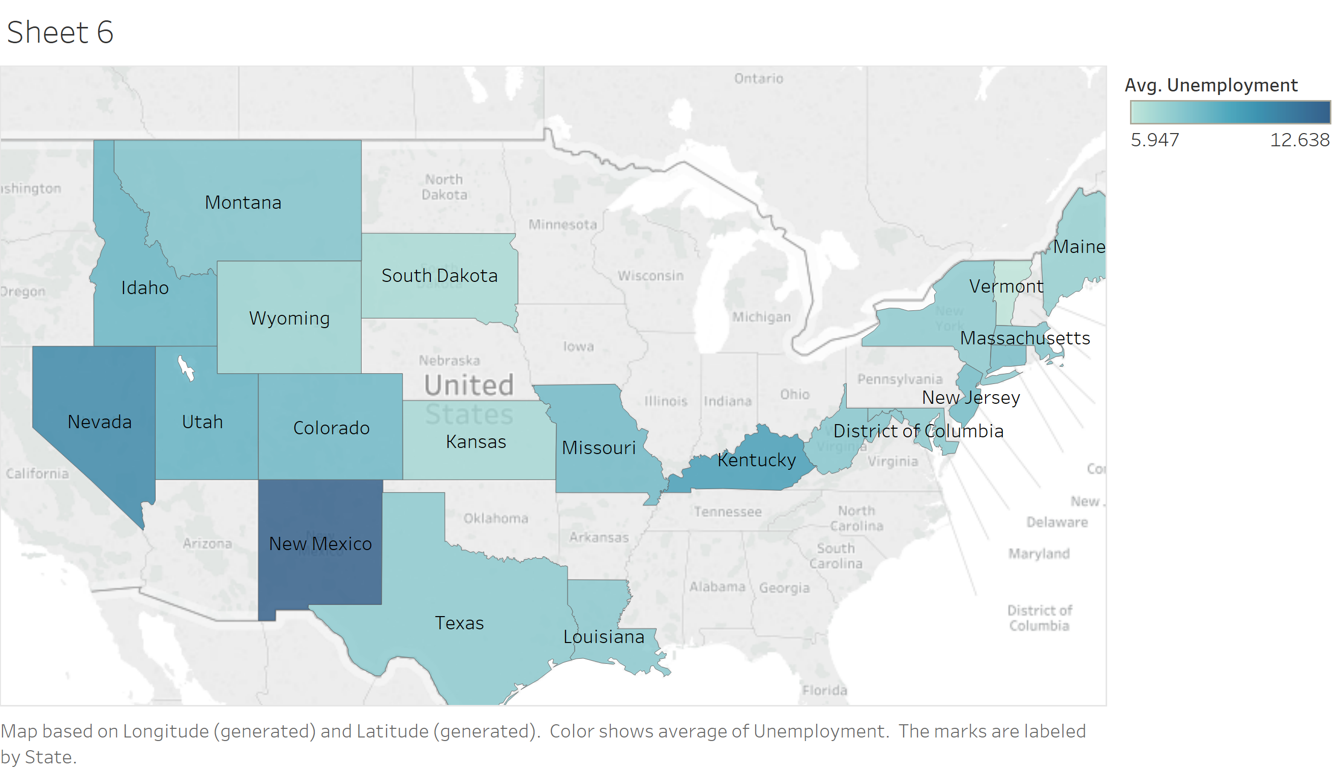

Slide 15
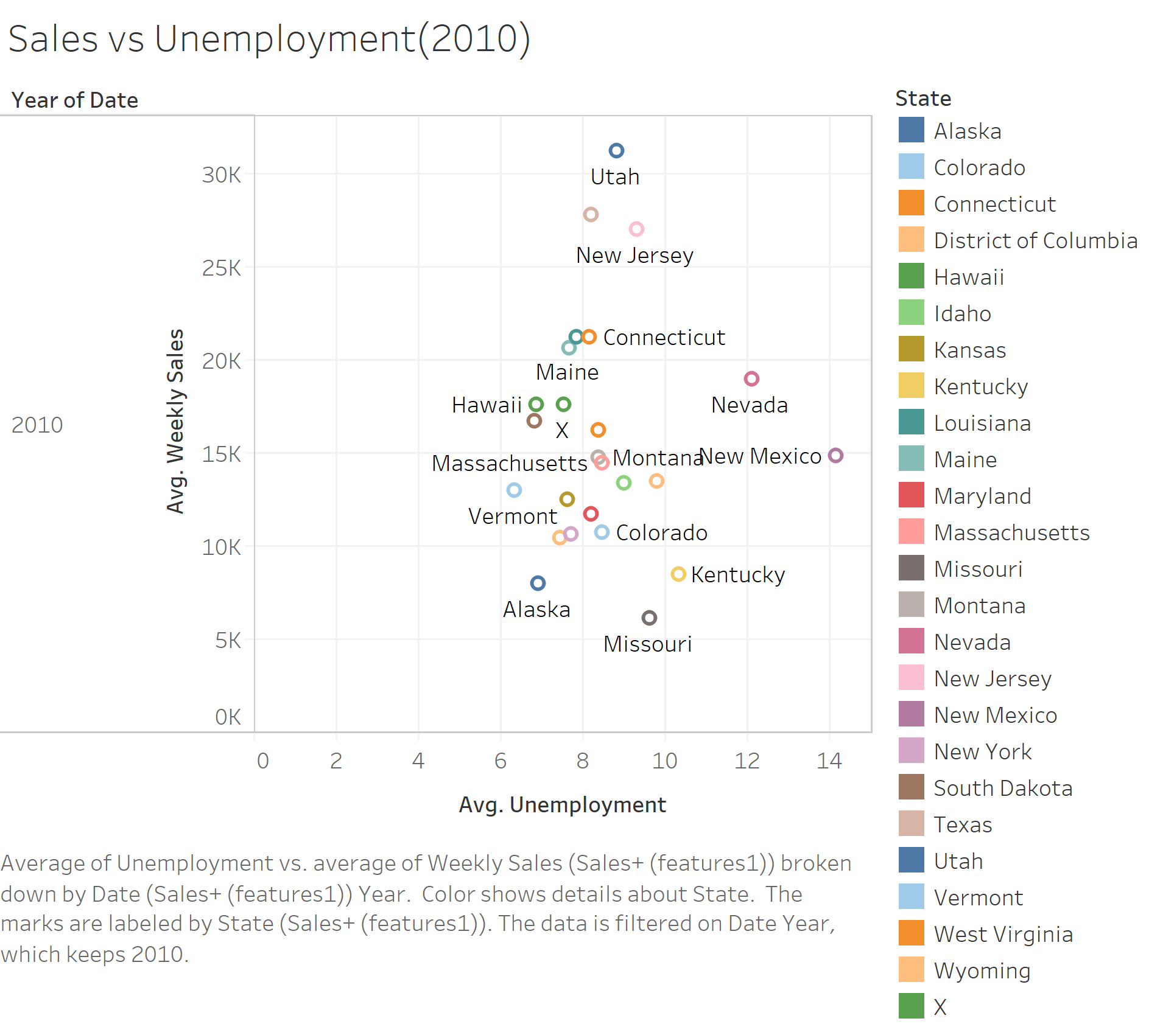
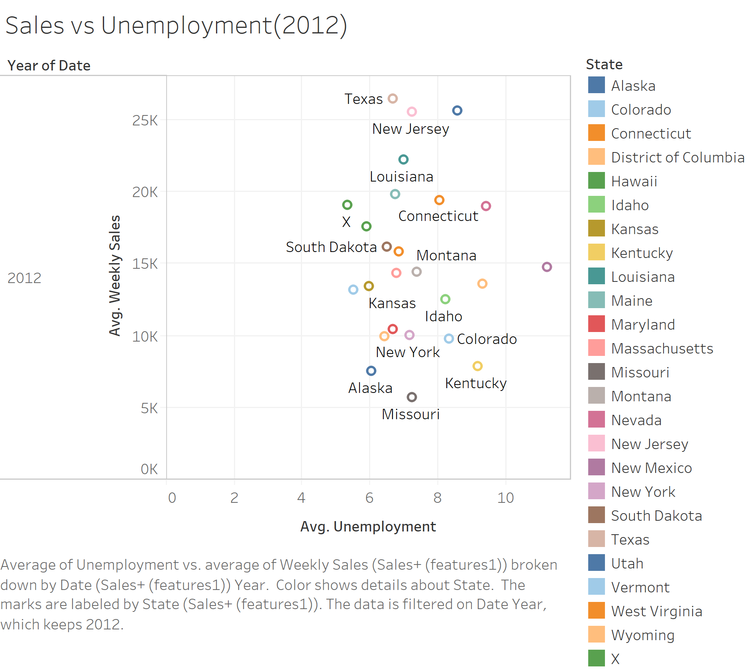
Sales of Stores in Texas has increased from 2010-2012
Project Group 3

Slide 16

Factors To Consider
Unemployment rate
&
Employment Growth rate
Population Density
CPI Index Comparison
Project Group 3

Slide 17
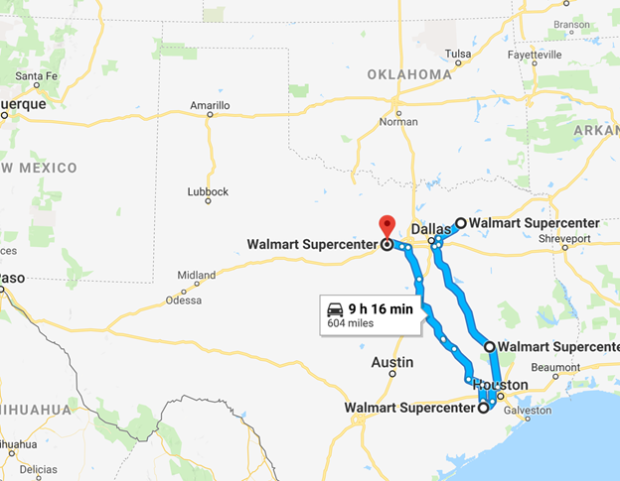
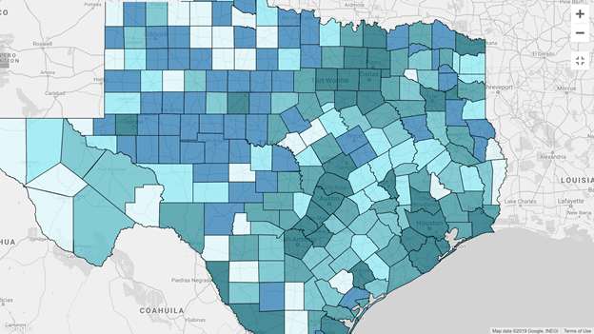
Population Density
Walmart Super centers in Texas
Total accommodation and food services sales, 2012 ($1,000)
Store Area:‘202307’sq.ft.
HUNTSVILLE
WEATHERFORD
GREENVILLE
RICHMOND
Project Group 3

Slide 18
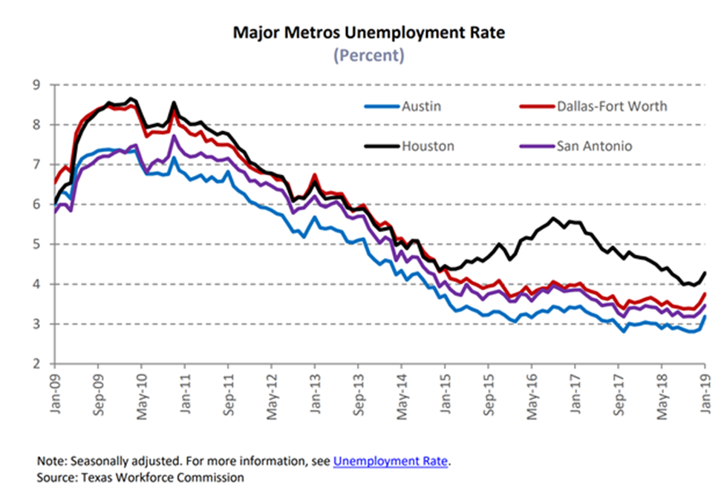
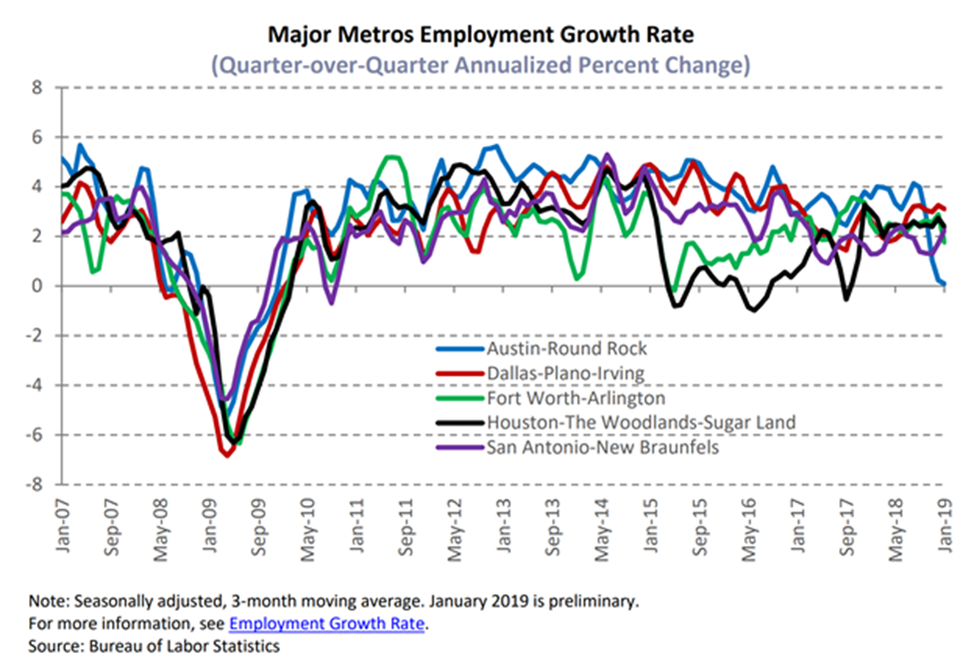
Unemployment rate
& Employment Growth rate
Project Group 3

Slide 19
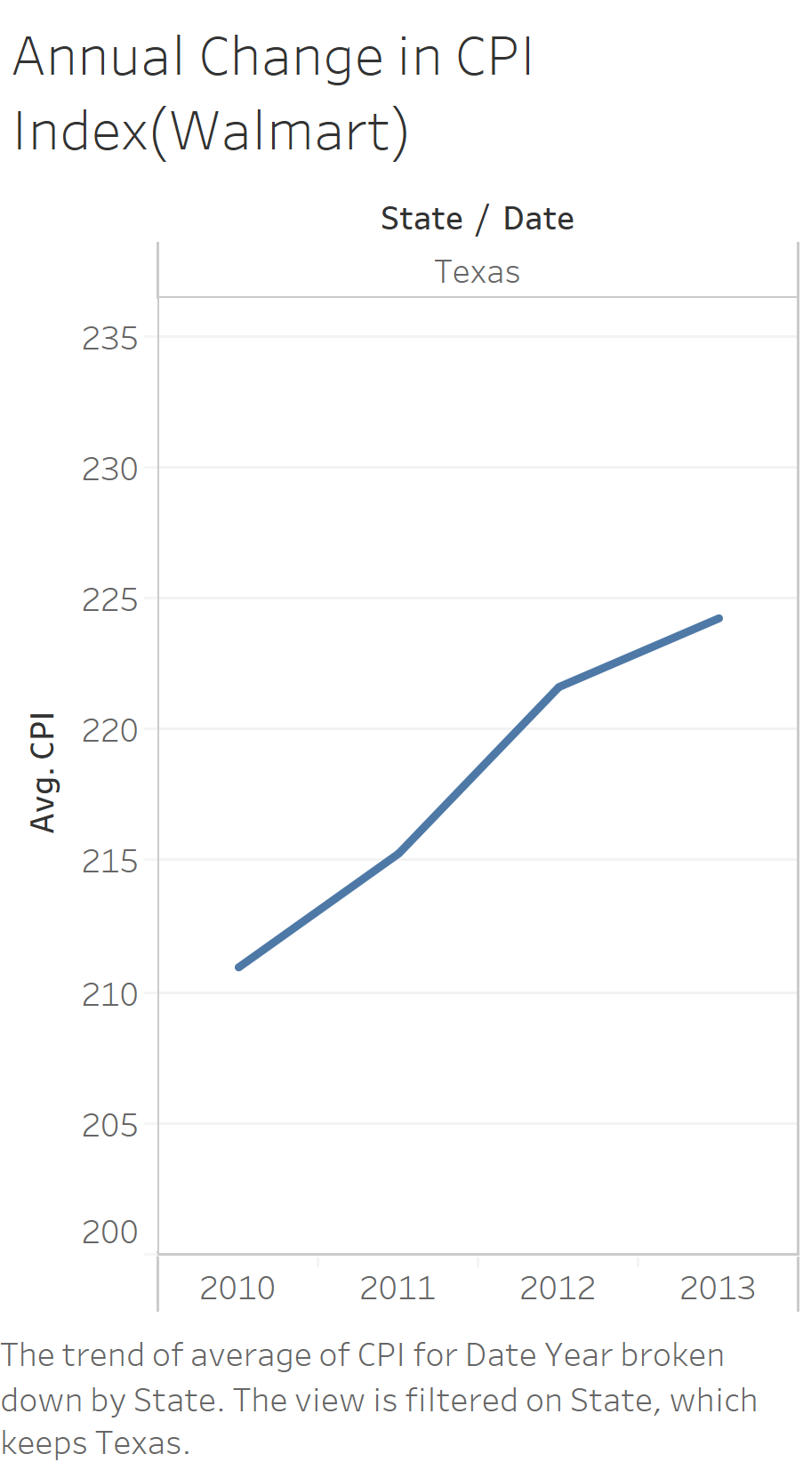
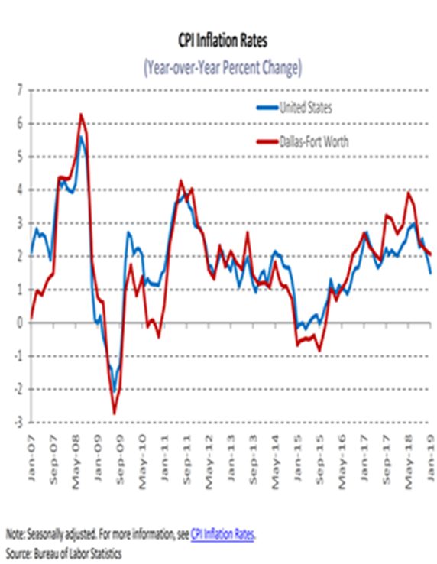
CPI Index Comparison
Project Group 3

Slide 20
Conclusion
Consumer Price Index, Promotional activities, Unemployment, Store size drive sales
Walmart should hit the ‘sweet spot’ for maximum revenue
From 2010 to 2012, Walmart generated the most revenue in 2011
Promotional activities were in abundant in 2011, especially social media
Walmart acquired Kosmix in 2011
Walmart in 2019
$500bn company increasing with 3-4 percent every year
Homegrown CEO – Dough McCollin
Change in company policy
Portfolio diversification
Can compete with Amazon for retail dominance
Project Group 3

Slide 21
QUESTIONS? COMMENTS?
LET US KNOW! THANK YOU!

